Slide 1
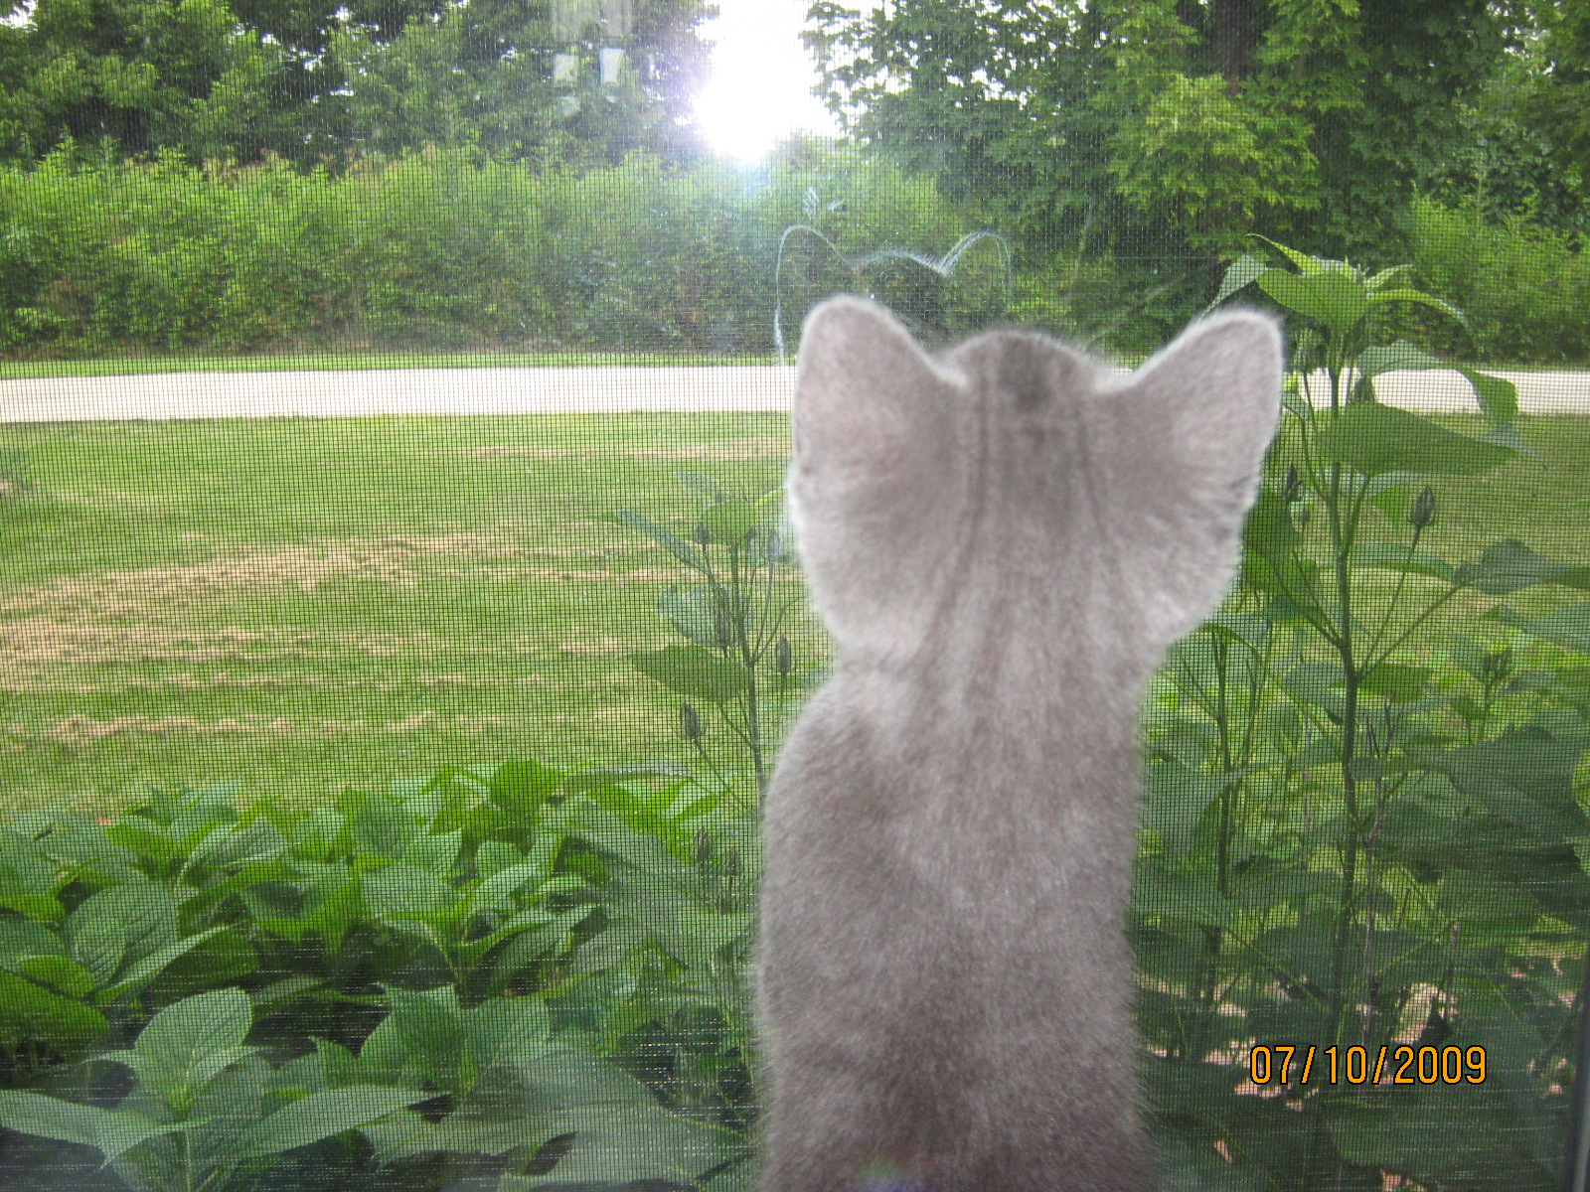
Meet Margaret Melinda Soto

Slide 2
I look like…

Slide 3
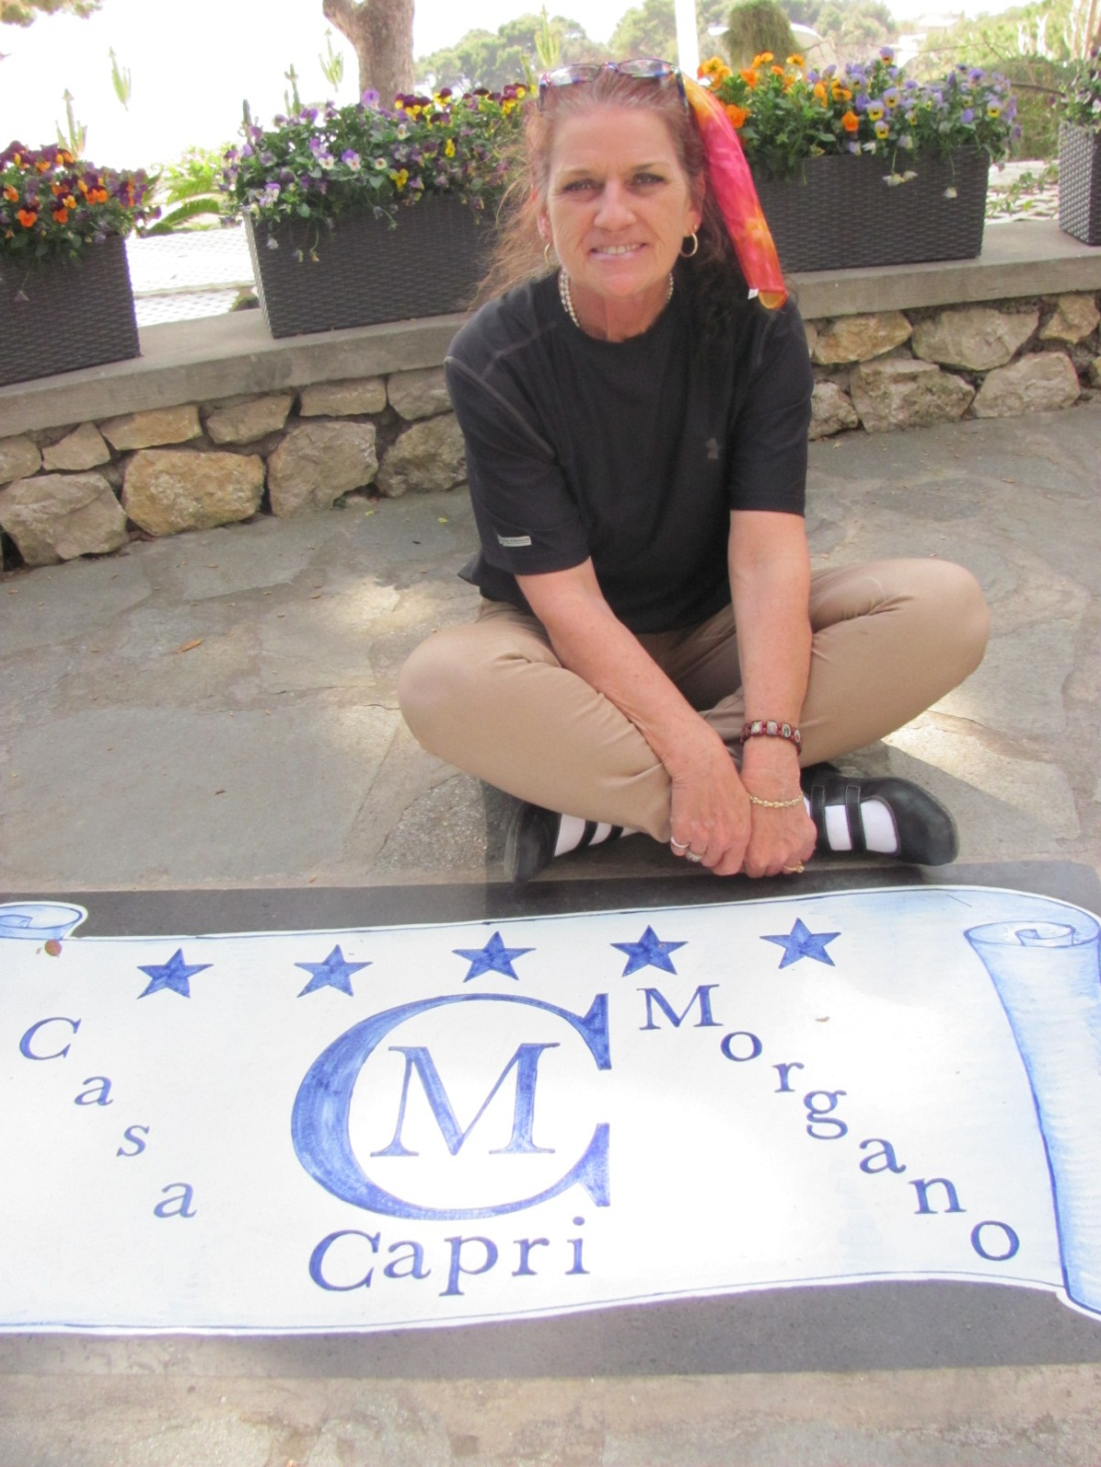
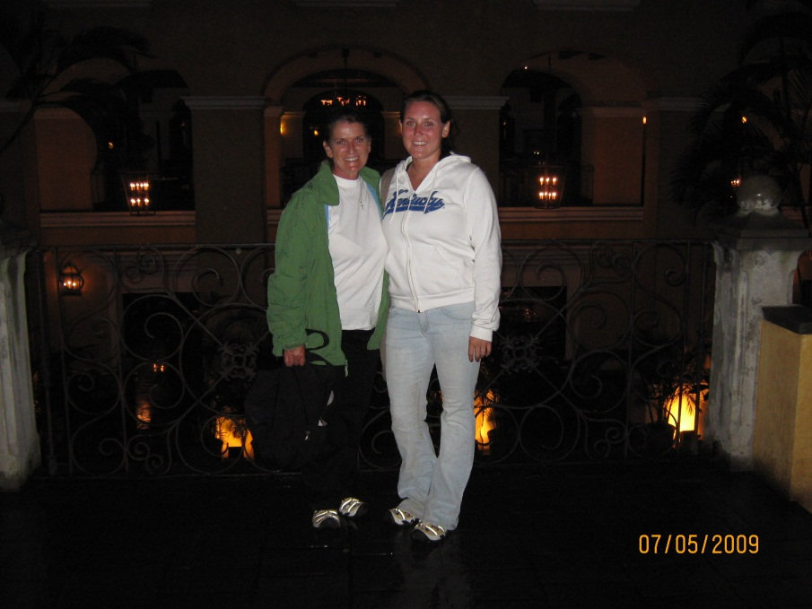

Slide 4
I like to think about…

Slide 5
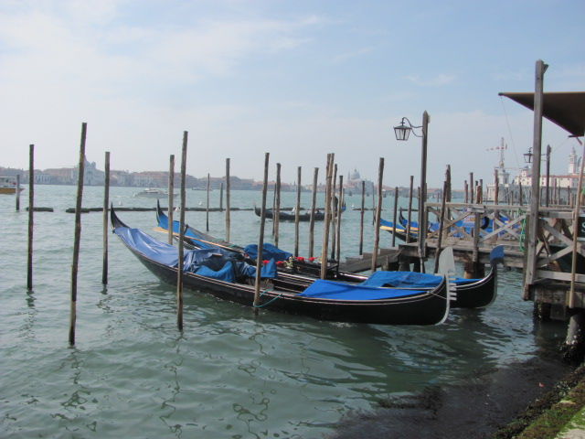
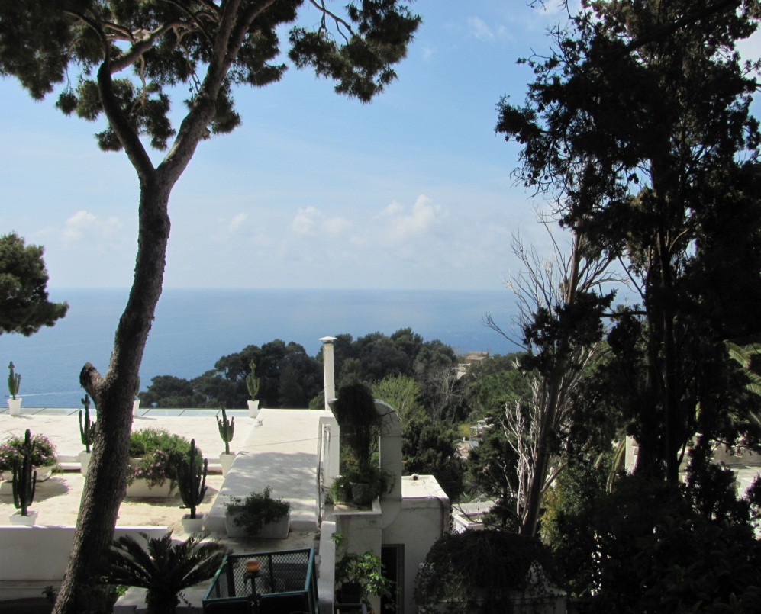
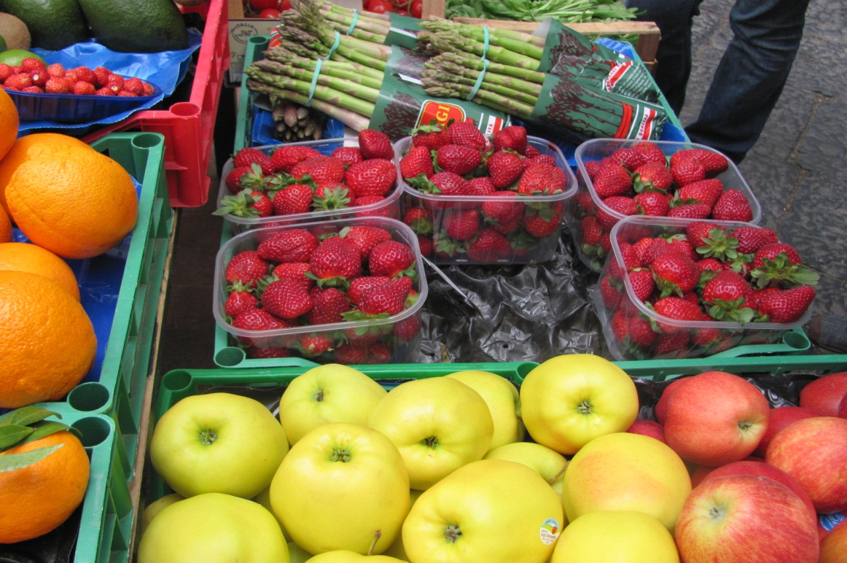
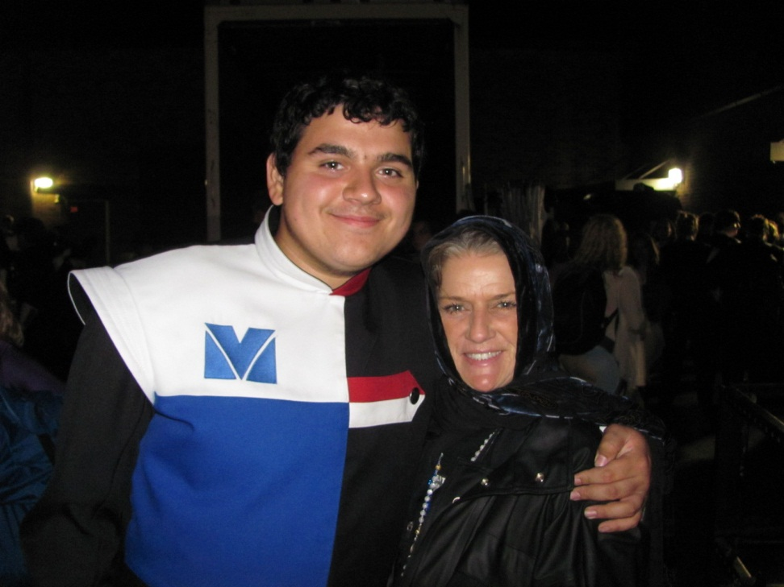

Slide 6
My best character trait is…

Slide 7
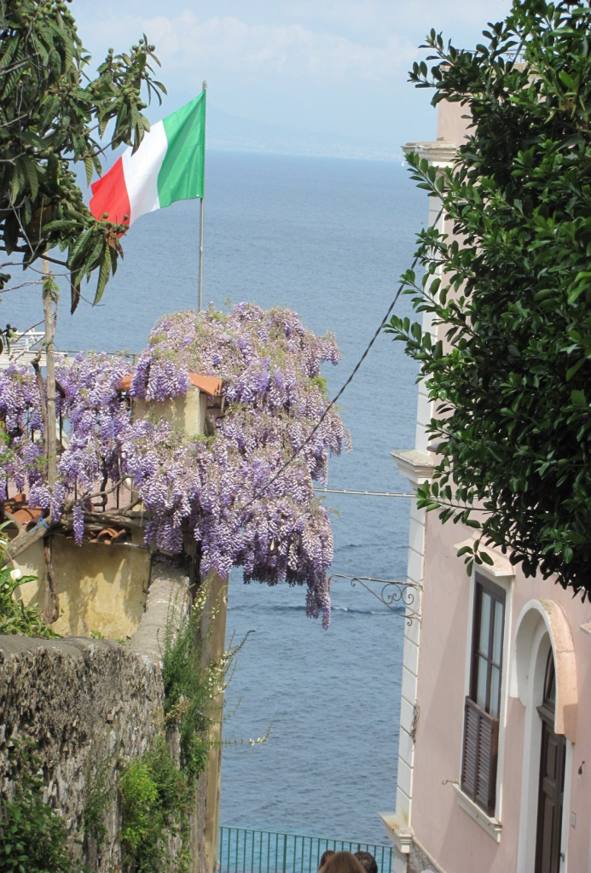
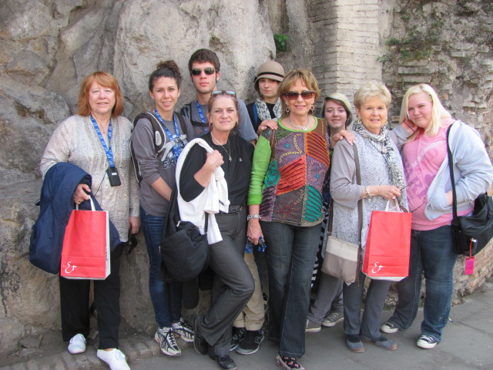
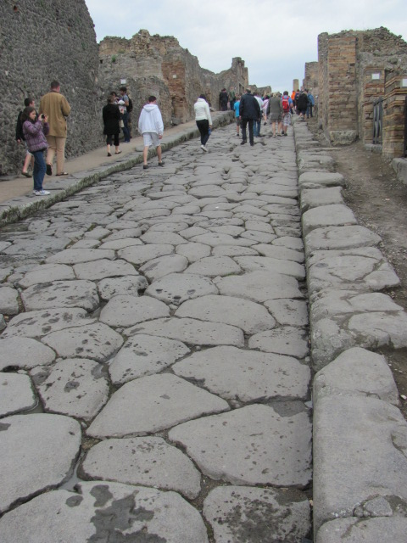
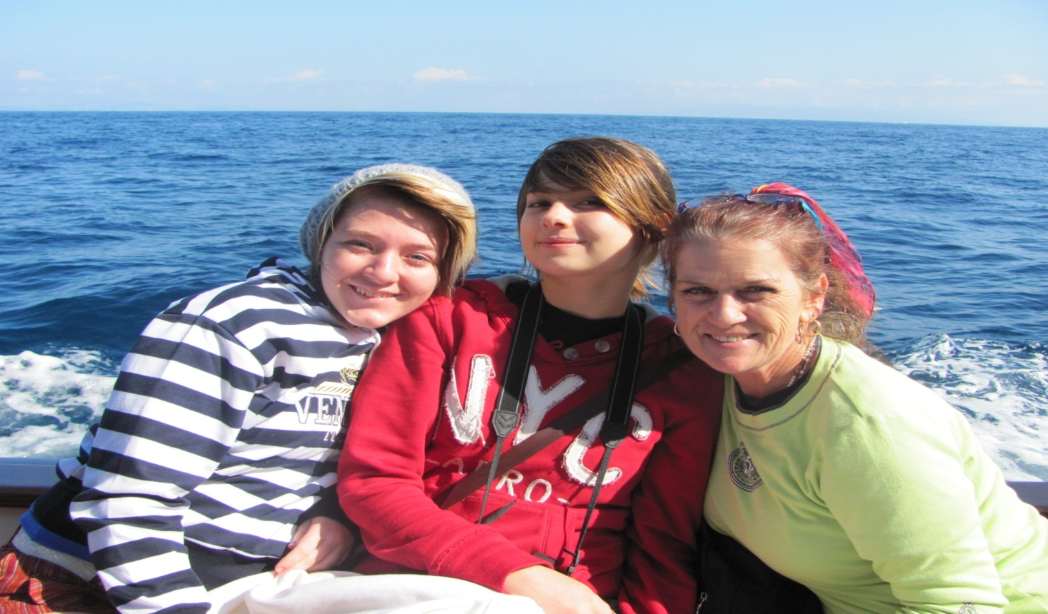
Love Hope Compassion

Slide 8
I would like to develop this trait…

Slide 9
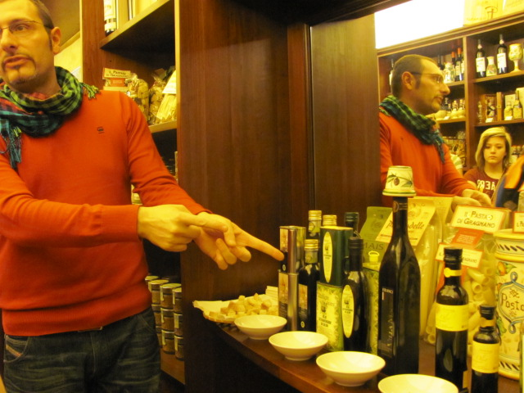

Slide 10
I am most scared of…

Slide 11
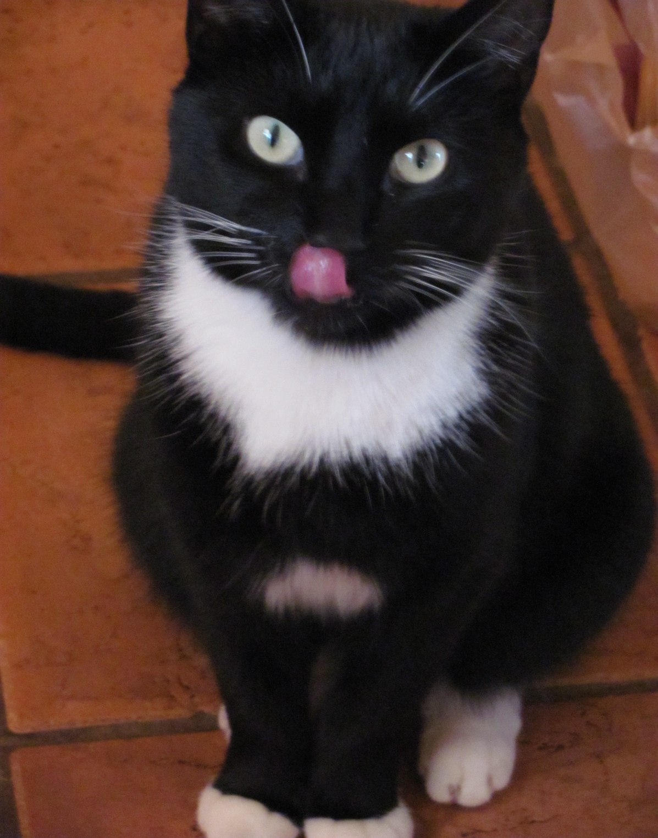

Slide 12
I am most interested in…

Slide 13
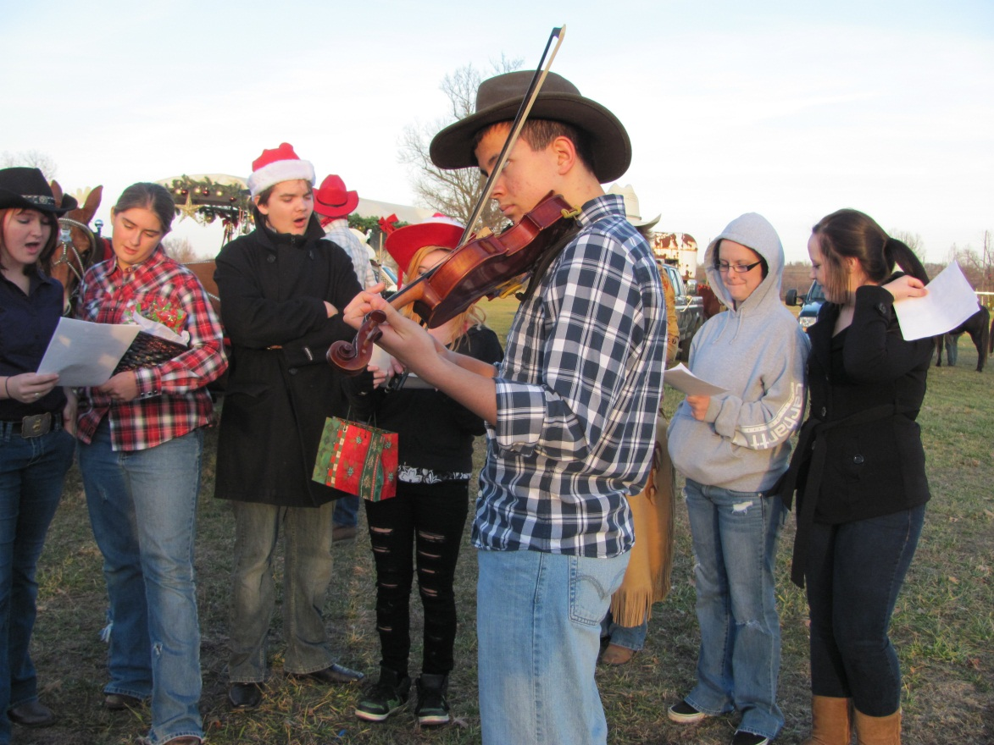
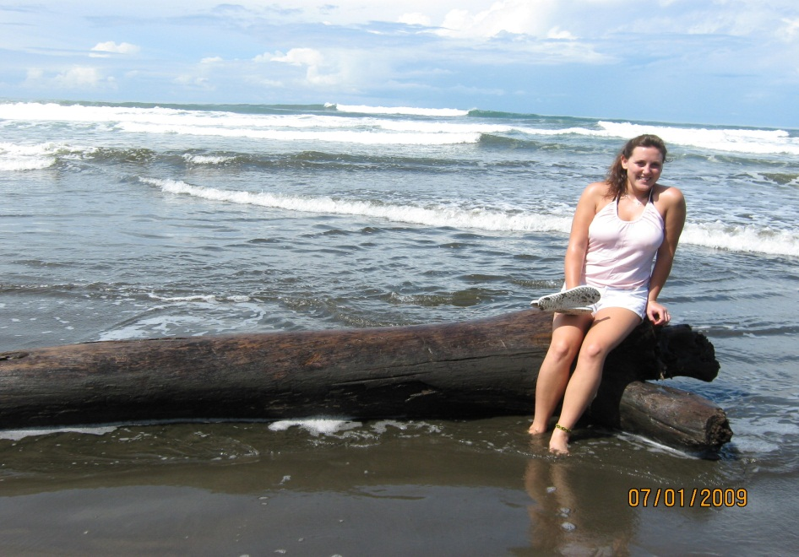
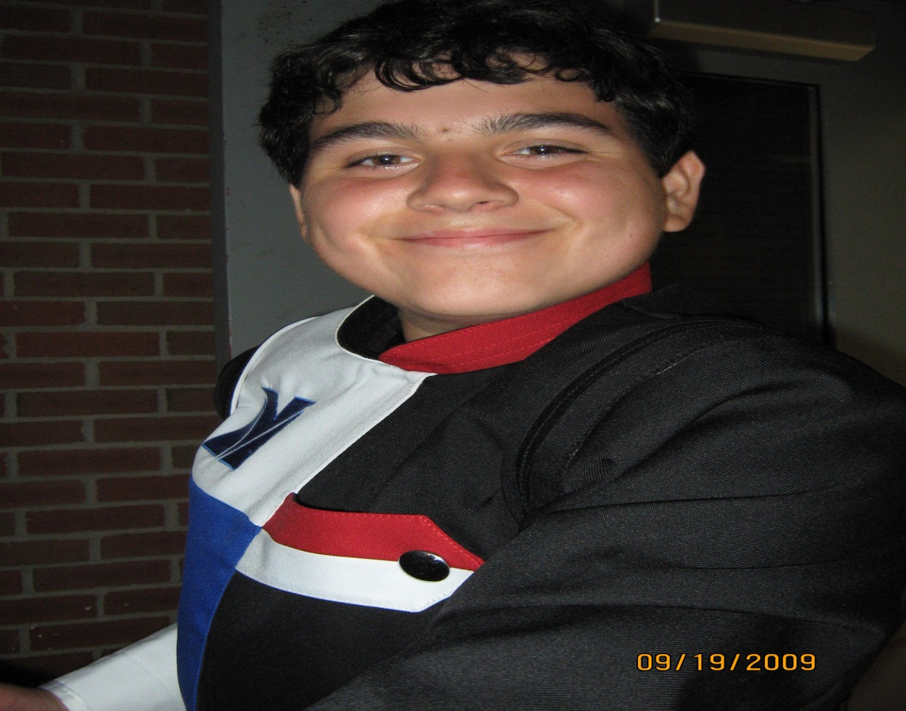
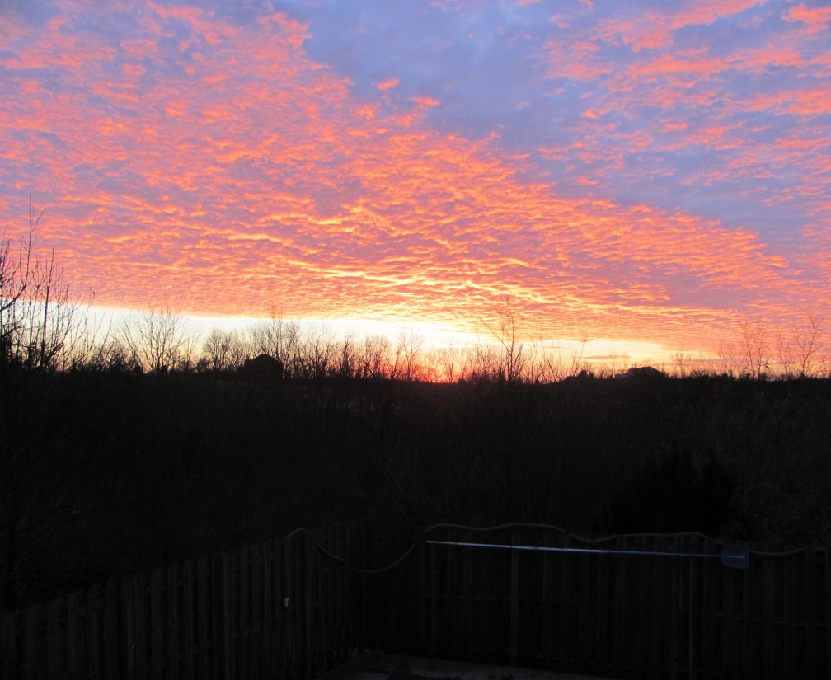

Slide 14
I get along best with….

Slide 15
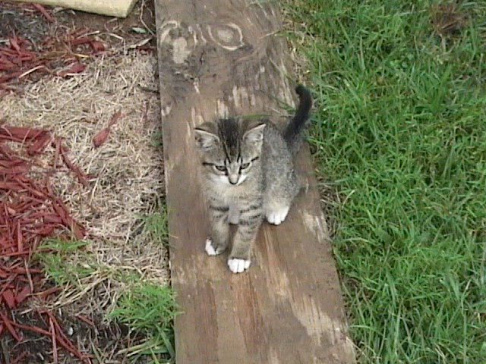

Slide 16
I learn best by…

Slide 17
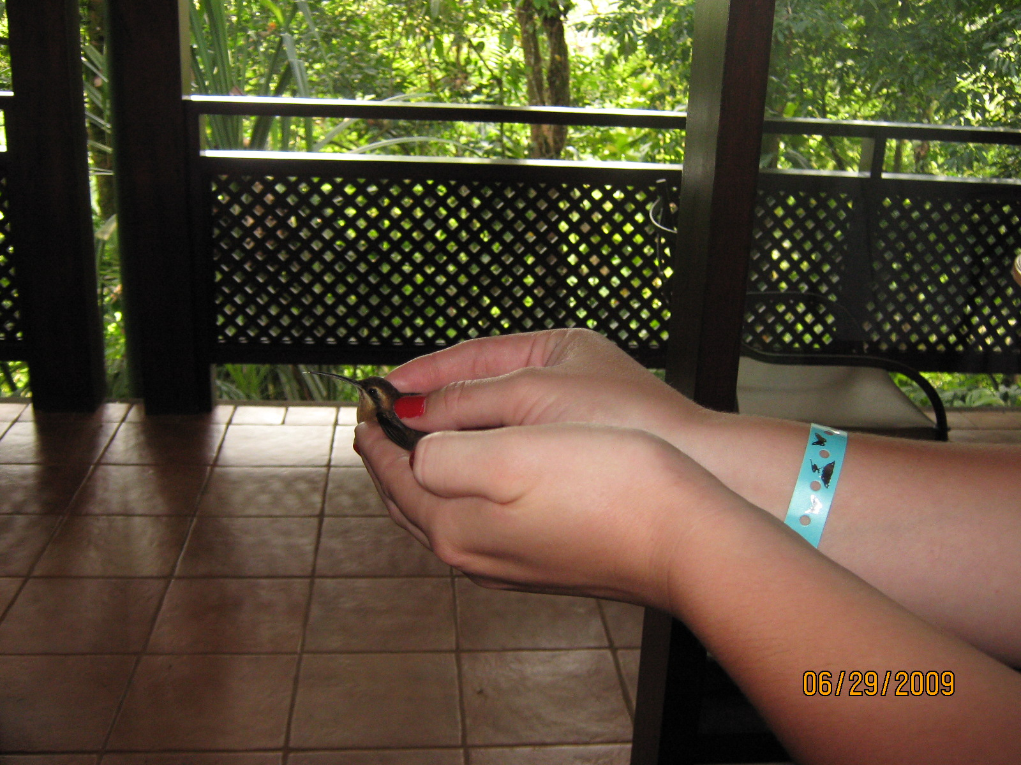

Slide 18
My best developed talent is…

Slide 19
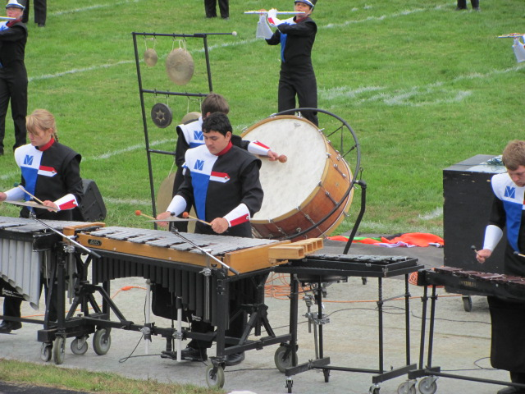
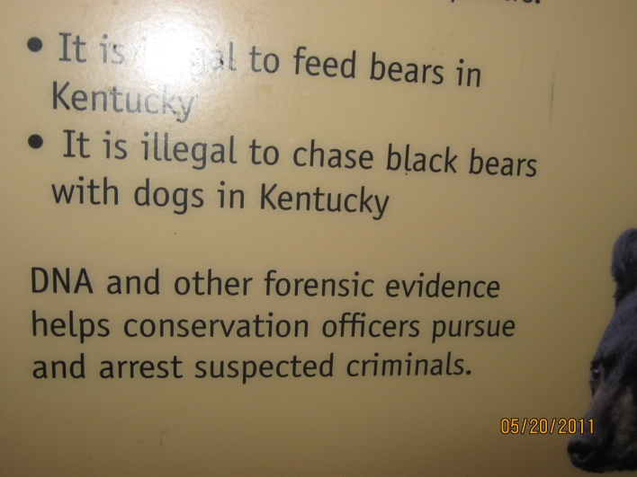
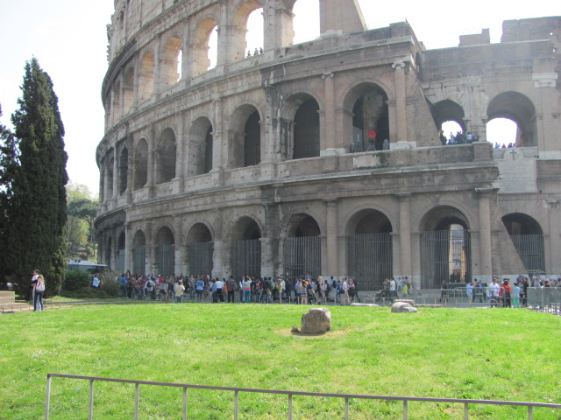
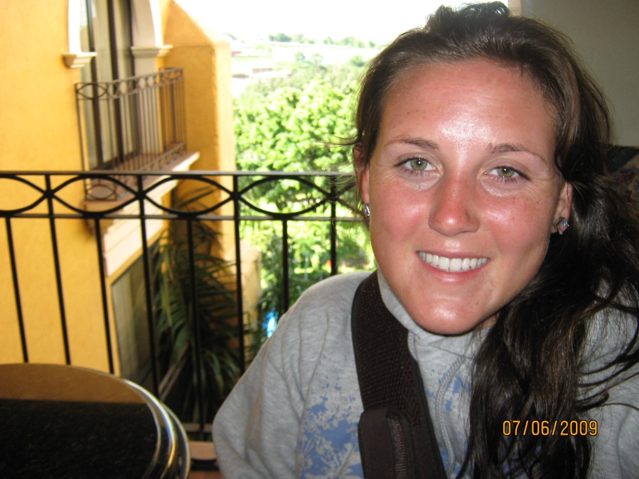
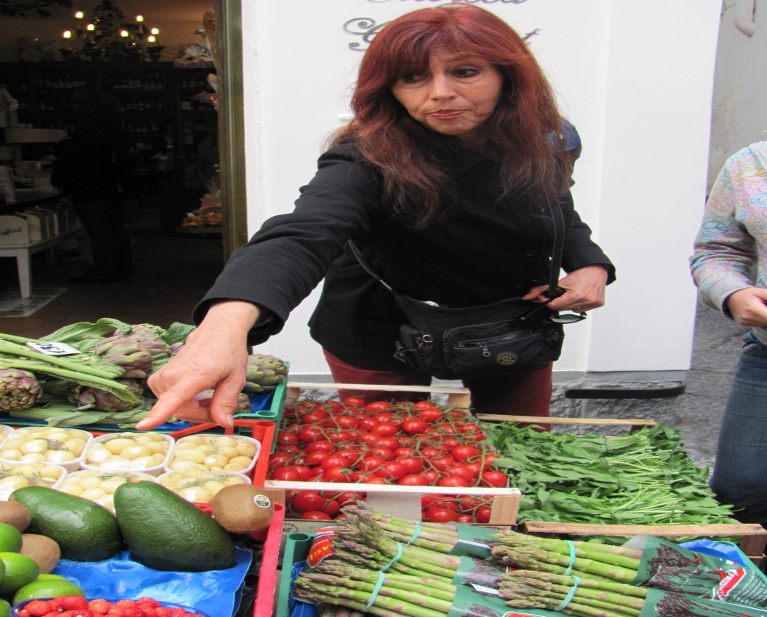

Slide 20
I would like to develop this talent…

Slide 21
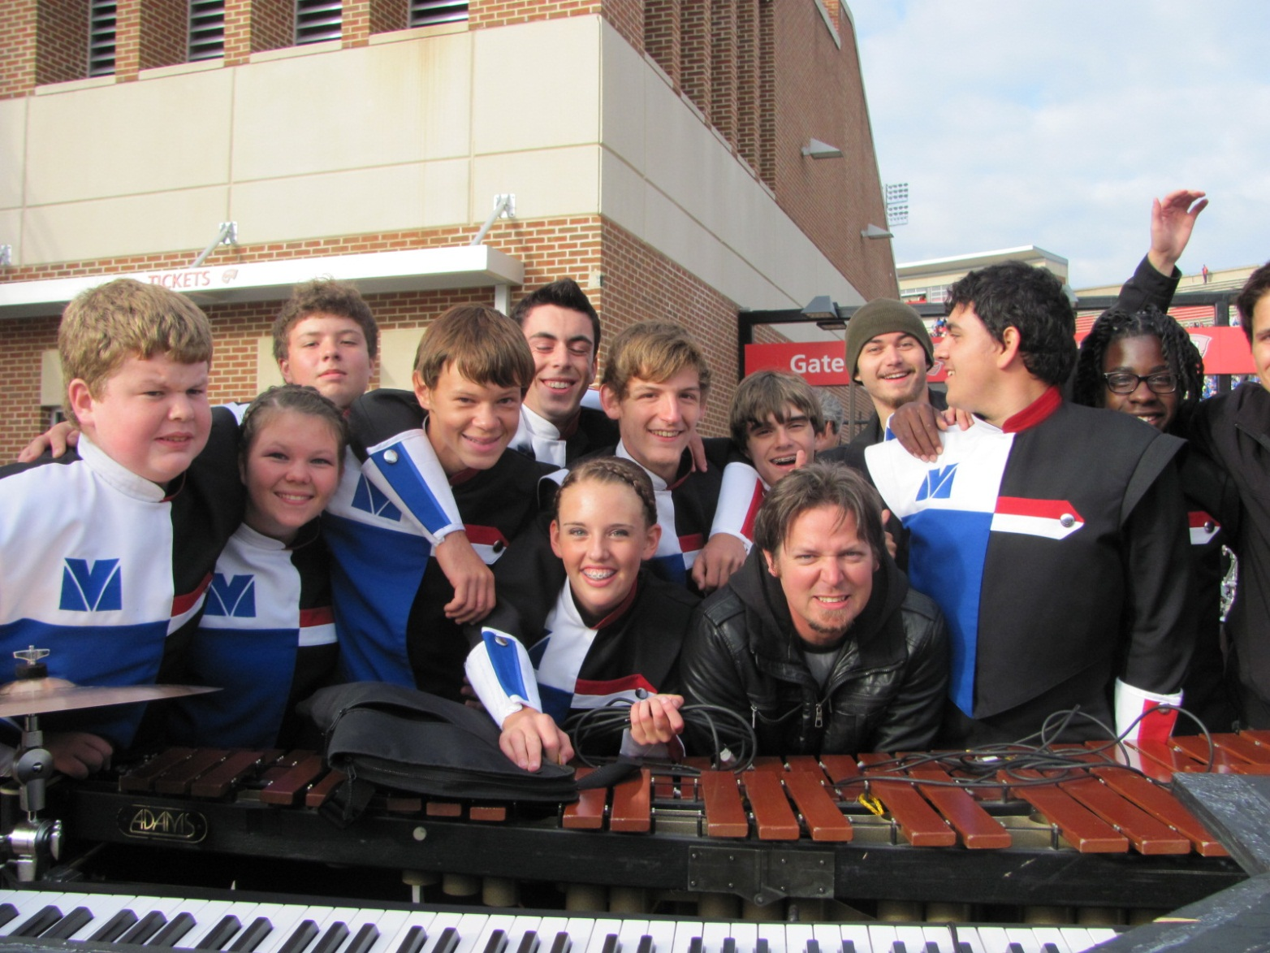

Slide 22
My secret dream is…

Slide 23
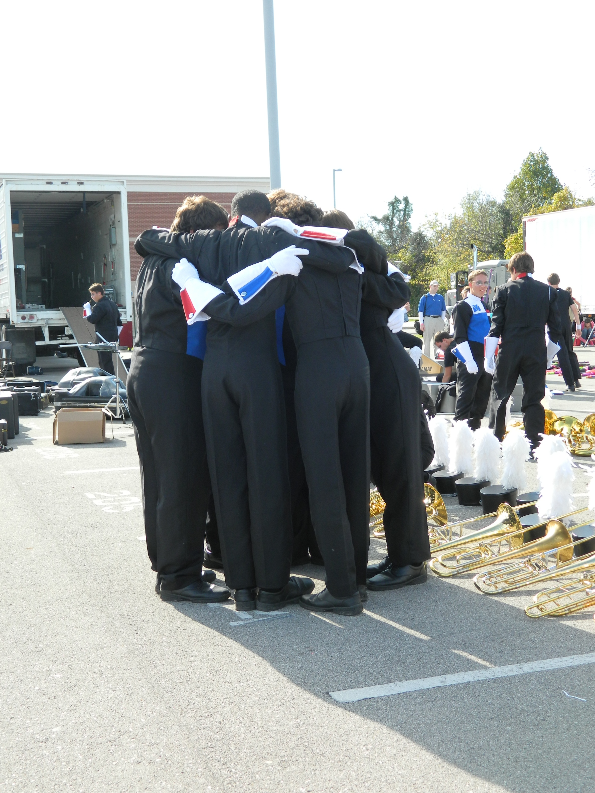

Slide 24
Ten years from now, I hope…

Slide 25
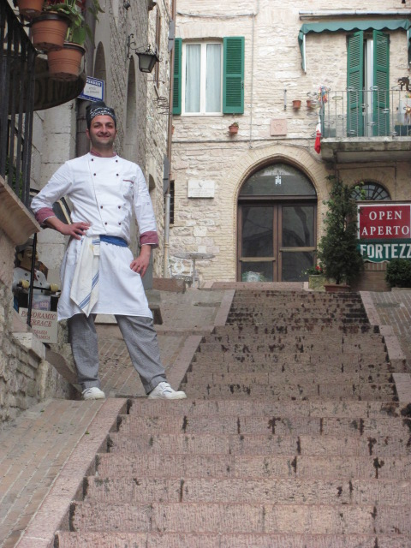
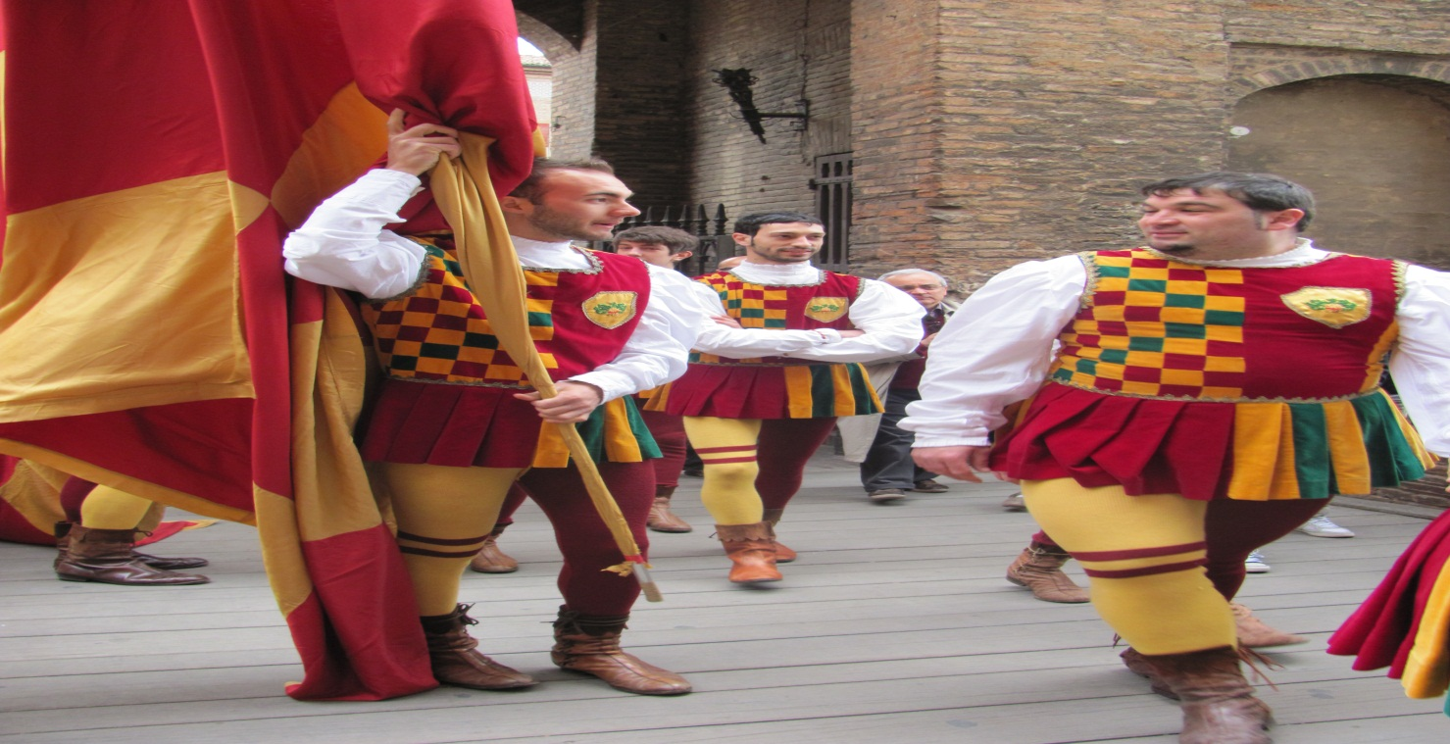
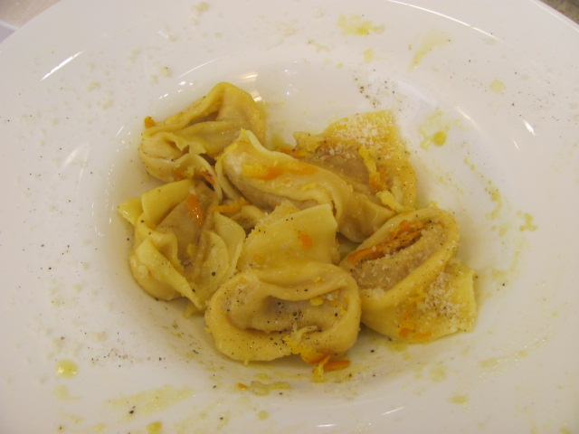
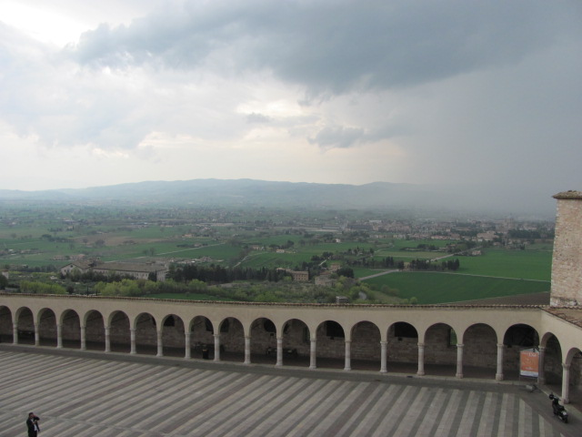

Slide 26
To reach my goal, I have to…

Slide 27
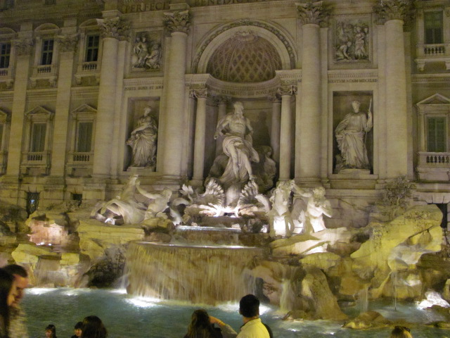

Slide 28
Reflection

Slide 29
I chose these photos to reflect my personality. I learned that I am not scared of too many things. I placed a picture of my beautiful cat to reflect one thing that I am scared of. I am not scared of “cats”, but I am very scared of rabies. I was bitten by a cat, that had rabies. So I am very aware of rabies and the consequences of that virus. I selected this genre’ because it is a great way to reflect. As the old saying goes, a picture is worth a thousand words. I am going to use this with Freshmen and Juniors. I believe they would feel comfortable and have success with this project. All students like to hear their name and they love to see pictures of themselves. So, this would be a great way at the beginning of the year to allow the students to introduce themselves and a way for all of us to learn a little more about one another.

